Slide 1

Website Updates
Notes:
I’m here to provide an update on the DDI Alliance website—covering the transition of technical hosting, progress in user experience improvements, and an important question about our publications section.

Slide 2
Transition of Technical Hosting
In December 2024, technical hosting of the DDI Alliance website transitioned from ICPSR to the DDI Technical Committee (TC). This included migrating the site to a new server and hosting account, site maintenance, security monitoring, technical troubleshooting, and accessibility compliance.
Technical Committee has primary responsibility for Product-related content, including the Product pages and much of the content currently listed under the Getting Started section.
Secretariat continues to manage content for membership and communication, which is most of the other content on the site.
Notes:
In December 2024, we transitioned the technical hosting of the DDI website from ICPSR to the DDI Technical Committee. The transition included migrating to a new server, setting up a dedicated hosting account, and transferring responsibility for site maintenance, security, accessibility, and technical troubleshooting.
For site content, we’ve divided page updates so:
The Technical Committee now owns product-related content.
The Secretariat continues to manage content related to membership and communications.”

Slide 3
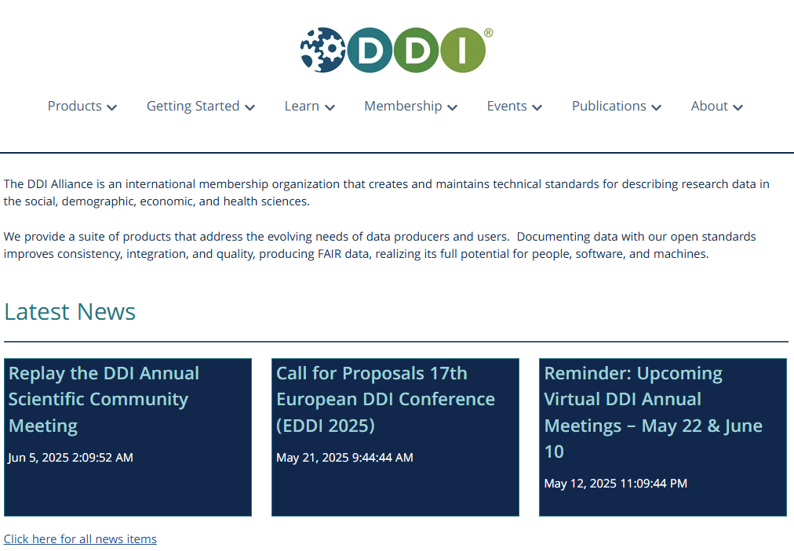
Notes:
This is what the migrated site looks like today (using HubSpot) after the initial lift-and-shift of the old Drupal site. Thanks to the Technical Committee for taking on this technical hosting.

Slide 4
UX Review - Findings
Area | Key Issue Identified | Strategic Recommendation
Navigation | Overly complex structure; hard to locate info | Simplify layout and terminology
User Interface | Inconsistent formatting; content overload | Apply uniform design templates
Search & UX | Poor discoverability; broken links | Add robust search and maintain broken link fixes
Accessibility | Color contrast, link labels, alt text lacking | Improve compliance with WCAG 2.1
Notes:
After the shift to the new site, an ICPSR UX consultant completed a comprehensive review of site content, navigation, and accessibility to identify friction points. What we heard was clear: users are looking for simplified content, easier navigation, and more intuitive organization—especially for first-time visitors trying to understand what DDI is and how to use it.”
[From UX interviews: “Confusing to organize by product and by task (and then output) under "Getting Started" – especially with a separate Products menu. Users unsure where to start: Learn, Getting Started or Products. Resources are somewhat surprising to find at the bottom of the Getting Started section.”]
The UX designer took the feedback and created design templates for several key sections.

Slide 5
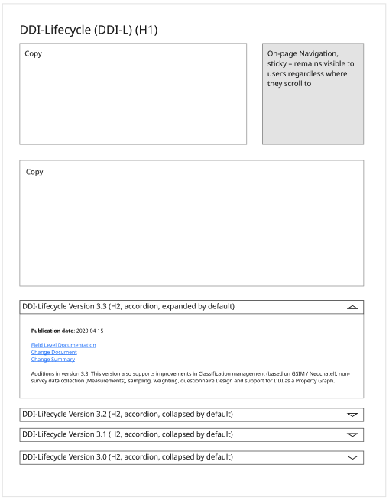
UX Mockup: Products
Notes:
Here’s a snapshot of a redesigned Products page template. It prioritizes clarity and discoverability. We’ve streamlined descriptions and added visual anchors to help users find the product version, documentation, and support materials quickly.

Slide 6
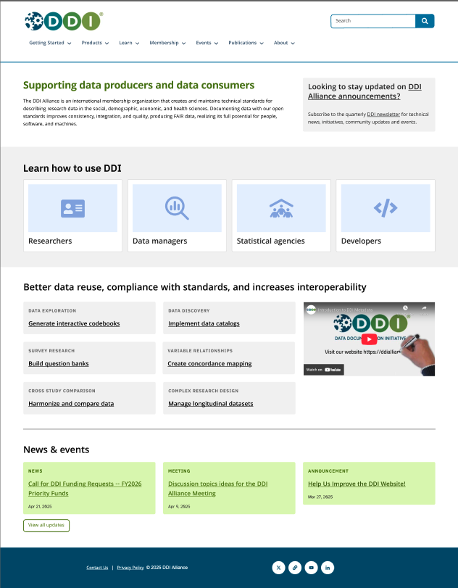
UX Mockup: Home Page
Notes:
Here’s a reimagined homepage mockup highlighting key resources and creating an immediate sense of what DDI offers. The new layout reduces clutter, centers on user needs, and adds search function.

Slide 7
UX - Phase 2
By end of summer:
User testing to decide on navigation menu and page placement
Apply page templates
Simplify page content
Implement redesigned homepage and search bar
Notes:
What’s next? By the end of summer, we plan to:
Conduct user testing to finalize the navigation structure
Apply new page templates site-wide
Simplify content across major pages
Launch the redesigned homepage and search bar
This phase will ensure the updates we implement are based on real user behavior.

Slide 8
Publications Section
Background
Previous site included a section cataloging DDI-related publications, presentations, posters, working papers, and workshops.
This functionality was not transferred in the website migration.
Questions:
Is maintaining a curated list of DDI-related publications a priority for the Alliance and its members?
If yes, who is willing to maintain them, including maintaining a submission workflow?
Notes:
*****
1. Click the “Polls” or “Polls/Quizzes” Button. On the bottom Zoom toolbar (desktop only), click Polls
2. Select the Poll you want to launch
3. Click “Launch”. Participants will see the poll pop up on their screen
4. Monitor Responses. Click End Poll when ready
5. Share Results (Optional). Click Share Results so everyone can see the outcome. You can also download the results after the meeting.
*****
A key decision point: the prior site included a section that cataloged DDI-related publications—working papers, posters, and workshops. That feature didn’t make the migration. The question to you now is:
Do we want to continue maintaining a curated list of DDI-related publications?
And if yes, who is willing to maintain it—including oversight of submissions and workflows?
This is an opportunity to align our communications and scholarship more tightly—but only if we have the resources and commitment to maintain it.

Slide 9
Questions?
Notes:
That concludes the update. I welcome your questions

